Slide 2
Web Application for Signature Extraction & Authentication
Project Guide:
Mr. Amrendra Nath Tripathi

Slide 3
Team Members
Vaibhav Tomar Vinay Chaudhary Vipin Uniyal
CCVT B4 CCVT B4 CCVT B4
Roll No 175 Roll No 182 Roll No 185

Slide 4
Introduction
Biometric systems are primarily used in two situations: identification and verification.
The handwritten signatures are one of the ubiquitous and important attributes of biometric identification, mainly due to their widespread use in the financial, administrative, and legal fields to verify an individual's identity.
Forging signatures are usually divided into three categories: simple, random, and simulated (skilled) forgery.
The signature verification system is divided into two types:
1. Online(Dynamic)
2. Offline(Static)
In this project the work is categorized in three parts:
1. Preprocessing
2. Modeling
3. Finding Accuracy

Slide 5
Problem Statement
One of the major challenges of offline signature verification is having very high variation in different signature samples.
The offline signature is usually captured by a scanner or any other type of imaging devices, which basically produces two dimensional signature images.
As signature verification has been a popular research topic through decades and substantial efforts are made both on offline as well as on online signature verification purpose.
There are many cases where authenticating offline signatures is the only option such as check transaction and document verification.
Because Of its broader application area, in this paper, we focus on the more challenging task- automatic offline signature verification.

Slide 6
Literature Review
Countless studies on scene text detection and recognition have been developed and published in the recent years.
One of the most common procedures used for the extraction of text from scene images is through an end-to-end recognition of scene text, which is divided into two sub-processes:
1. Scene text detection
2. Scene text recognition
The output of these models contains the words (in this case, the signature) present in the image.
The process of verification of the extracted signatures has been achieved through the use of Convolutional Neural Networks (CNN), since neural networks are commonly used for both writer dependent and independent systems.^{[3]}
This project makes the use of the Siamese Neural Networks, which uses twin CNNs, for verifying the authenticity of the signatures.^{[4]}

Slide 7
Objectives
The aim of this project is to create a web-application that will check the authenticity of signatures with the help of deep learning.
Given a dataset A (Used for learning) that contains real signatures from a group of users, using which we can train the model and store it in set t1(train data).
The model is then used for authentication, the user tries to claim his or her identity and provides a signature image.
The model then tries to classify the signature, whether it belongs to the genuine category or forged category.
To calculate the accuracy of the system, we consider a test set t2(test data) consisting of forgeries and real signatures.

Slide 8
Methodology
This project consists of two main parts: Preprocessing of extracted image and modeling of dataset to train the system and testing accuracy.
Using Euclidean distance as the distance metric, comparison of the original and processed signature images.
Pre-Processing:
1. Signature Extraction
2. Noise Removal
3. Invert Image
4. Resizing
Dataset Modeling:
1. CNN & Siamese Network
2. CEDAR
Web-Application Creation

Slide 9
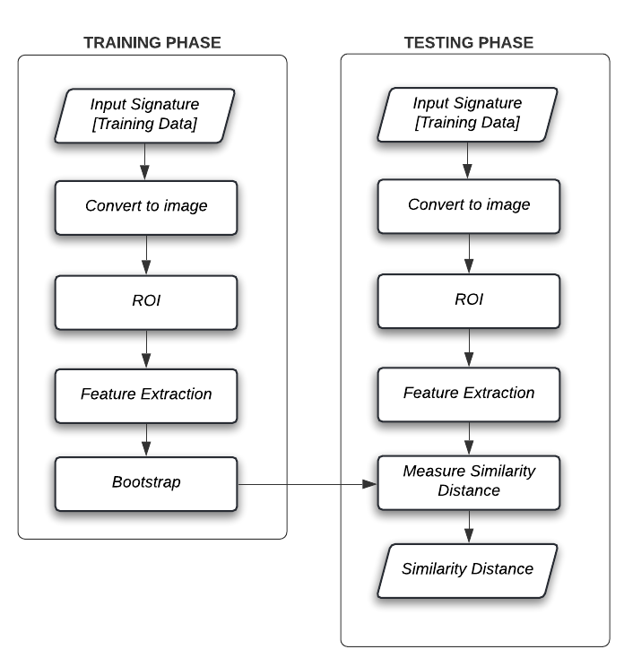
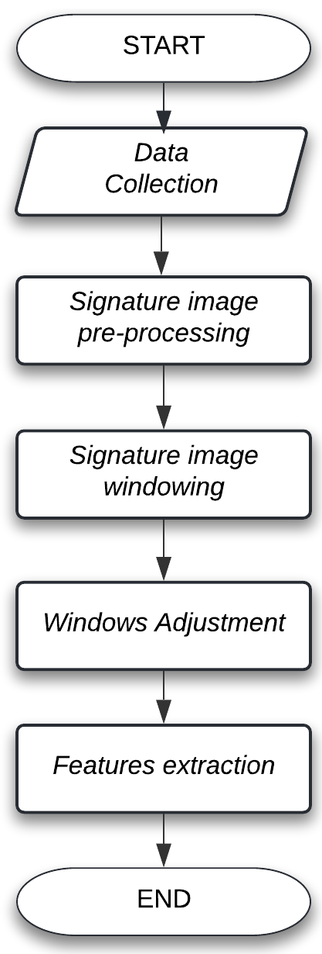
Methodology
Fig 1: Signature Extraction from given image
Fig 2: Training & Testing phases for Signature verification process

Slide 10
System Requirements
Python libraries used in development : pyTorch, opencv, keras, flask.
Software specific requirements
Operating System : Windows 7/ Ubuntu 16.0 or above.
Compiler : Python 3.8 compiler with flask module.
Web Browser : Google Chrome, Mozilla Firefox [preferred].
Hardware specific requirements
Processor : Intel Core i5-9400F
Processor Clock Speed : 2.1 GHz
GPU : Nvidia CUDA Enabled GPU
RAM : 8GB or Above

Slide 11
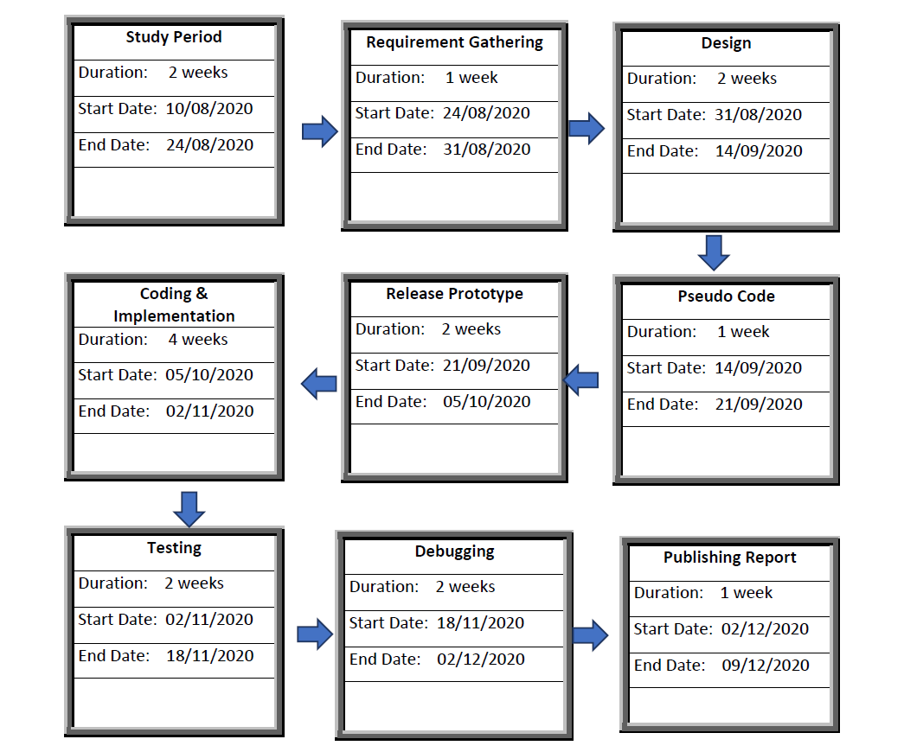
Project Schedule

Slide 12
References
Bartz, Christian & Yang, Haojin & Meinel, Christoph. (2017). STN-OCR: A single Neural Network for Text Detection and Text Recognition.
Vaibhav Goel, Vaibhav Kumar, Amandeep Singh Jaggi, Preeti Nagrath, "Text Extraction from Natural Scene Images using OpenCV and CNN", International Journal of Information Technology and Computer Science(IJITCS), Vol.11, No.9, pp.48-54, 2019. DOI: 10.5815/ijitcs.2019.09.06.
L. G. Hafemann, R. Sabourin and L. S. Oliveira, "Offline handwritten signature verification — Literature review," 2017 Seventh International Conference on Image Processing Theory, Tools and Applications (IPTA), Montreal, QC, 2017, pp. 1-8, doi: 10.1109/IPTA.2017.8310112.
Dey, Sounak, et al. "Signet: Convolutional siamese network for writer independent offline signature verification." arXiv preprint arXiv:1707.02131 (2017).
S. Chopra, R. Hadsell, Y. LeCun, Learning a similarity metric discriminatively, with application to face verification, in: CVPR, 2005, pp. 539–546.

